Slide 1
Christmas v Sport

Slide 2
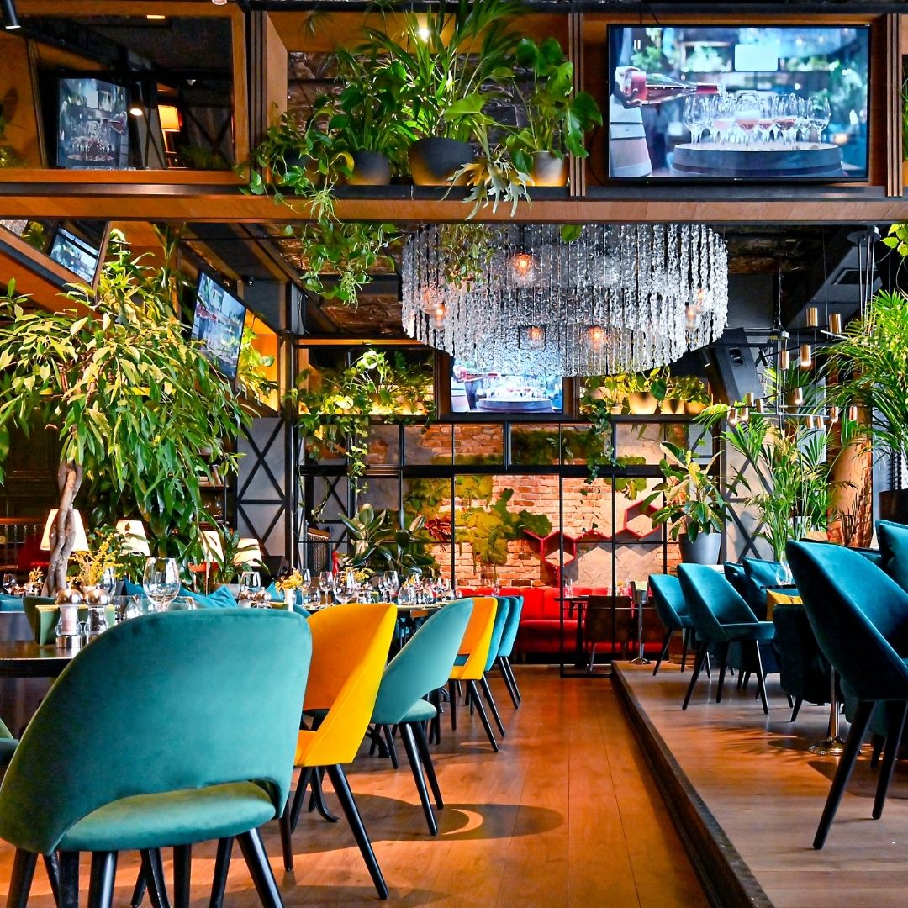
ABOUT US
Strategic Sales and Marketing experts for Hospitality and Leisure.
Founded by Amber Staynings in January 2019, we are so proud to boast a diverse client portfolio that spans multisite UK wide corporate enterprises, as well as small independents, with a team of highly skilled consultants working across the UK.
We IDENTIFY Sales Opportunities with Health Checks & Audits.
We CREATE Strategic Sales & Marketing Plans.
We DELIVER Consultancy & Training.
© Bums on Seats 2022​

Slide 3
OUR CLIENTS
“Absolute experts in the industry.
BOS is made up of extremely knowledgeable individuals!"
Sophie Herbert
Sales & Marketing Director - Beds & Bars
"Professional, Experts, Adaptable
- quite simply, they get results."
Kiran Quinn
Marketing Director - Greene King

Slide 4
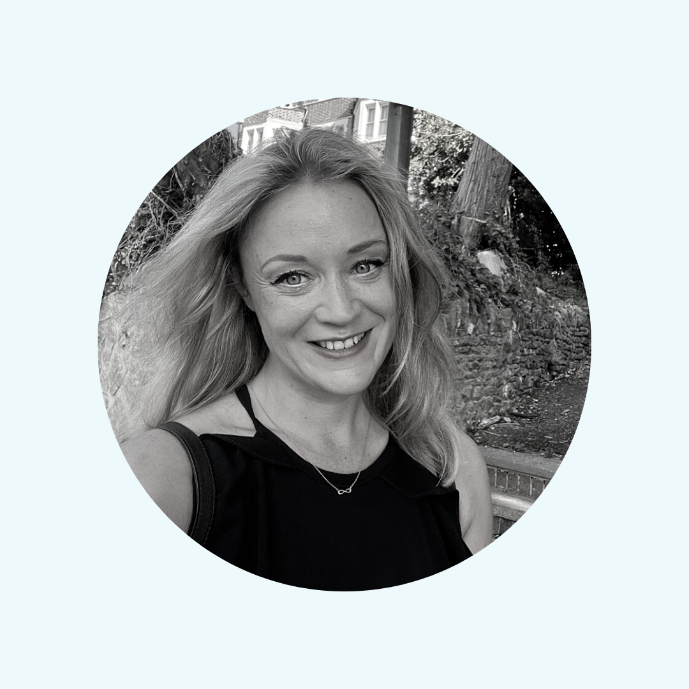
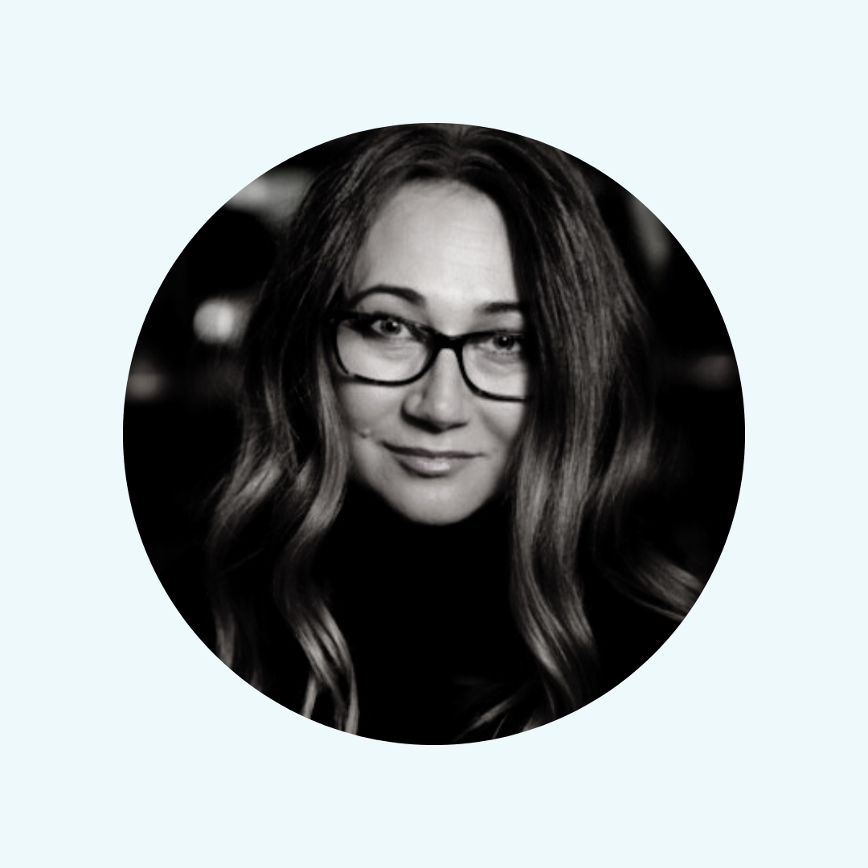
MEET YOUR HOSTS
Dee Sturgess
Director of Training
Amber Staynings
CEO & Founder
© Bums on Seats 2022​

Slide 5
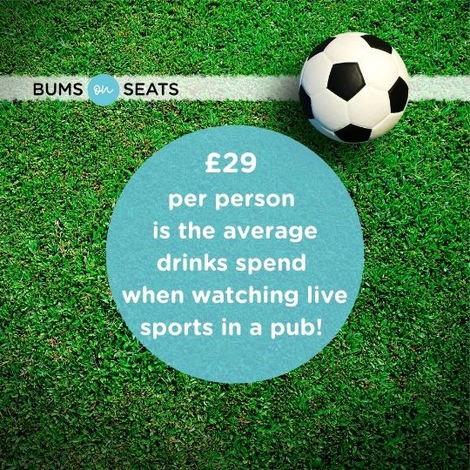
OPPORTUNITY
Average table booking size for the Euros in 2018 was 7.8 people.
Searches for venues hosting the world Cup screenings were up over 30% in June 2022.
51% of those surveyed said atmosphere was the driver for selecting where to book.
*Data taken consumer survey by Design My Night – Access Group - June 2022.
© Bums on Seats 2022​

Slide 6
CORE STRATEGY
Choose your side: Festive, Footie or both?
Can you deliver an experience for both, and will it impact your core trade long term?
Footie
What is your brand ID?
Who is your customer?
Festive
© Bums on Seats 2022

Slide 7
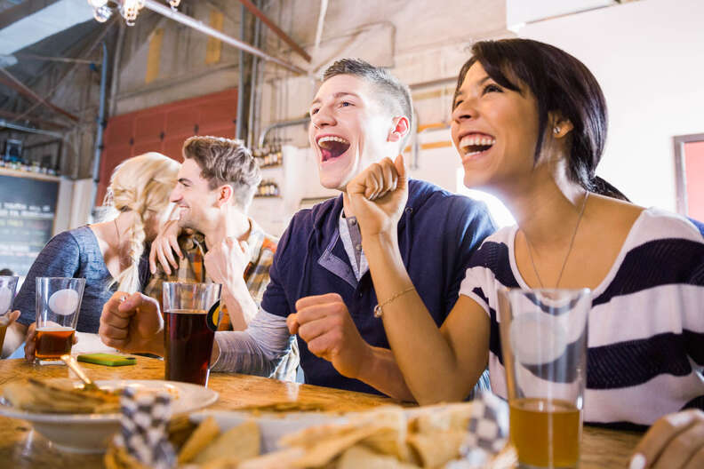
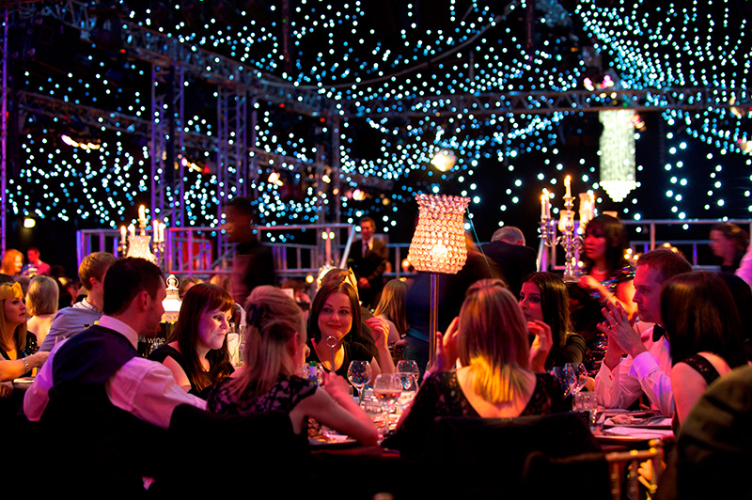
A GAME OF TWO HALVES
Choose Your Side!
If you are driving both Festive & Footie bookings, consider the sales and pre-booking planning logistics as important as the operational ones!
Here’s our failsafe checklist to consider when planning, to ensure you maximise revenue without compromising either event.
© Bums on Seats 2022

Slide 8
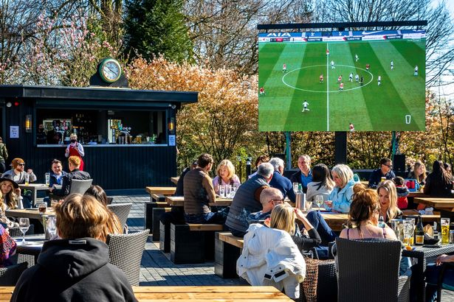
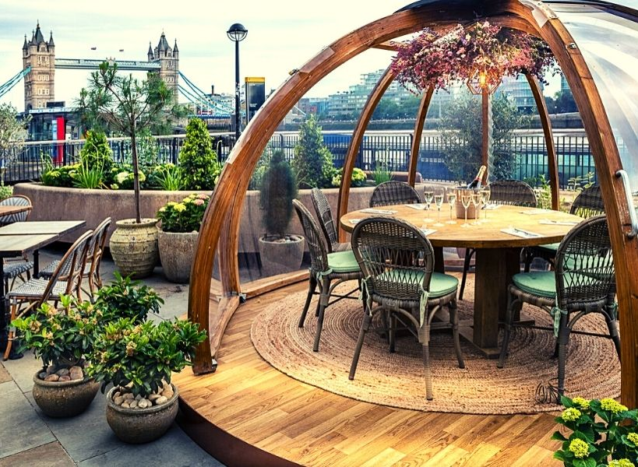
A GAME OF TWO HALVES
Venue layout:
How can you best utilise your bookable space?
Are there any areas you can repurpose?
Will outside areas be viable?
If so, what's the bad weather plan?
© Bums on Seats 2022

Slide 9
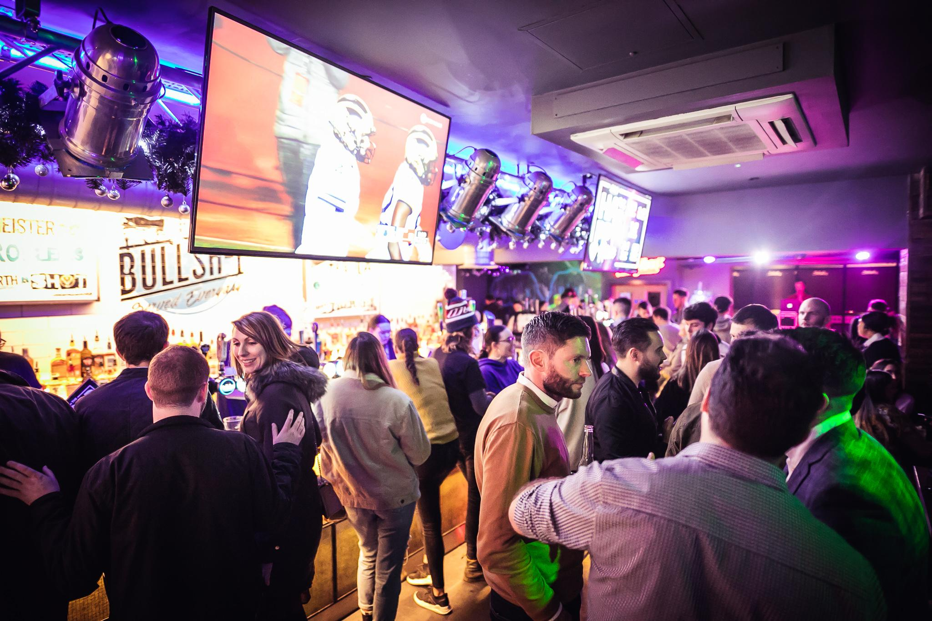
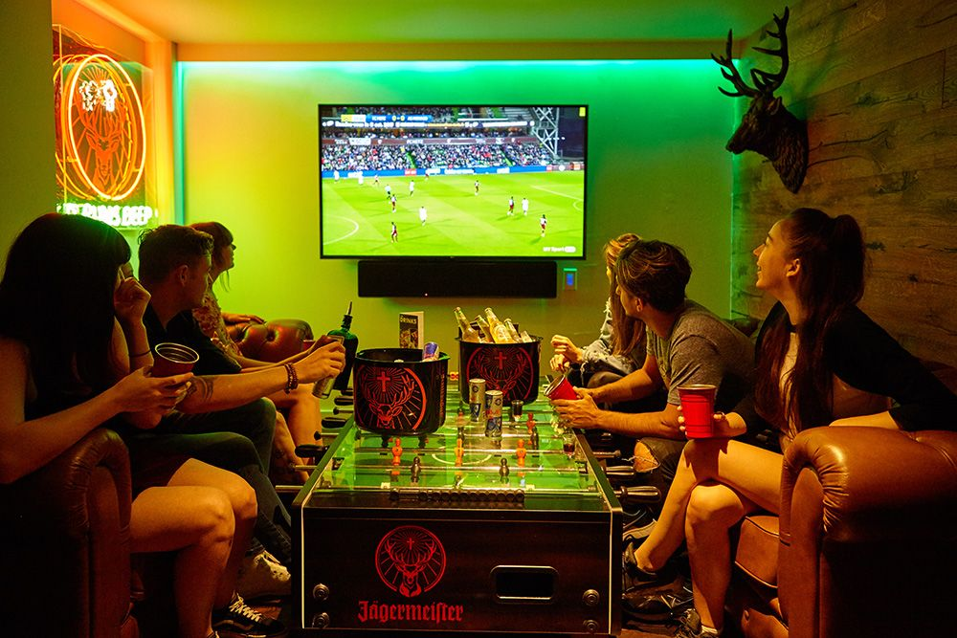
A GAME OF TWO HALVES
Pre-booked Packages or Tickets?
If you’re lucky enough to have ample standing capacity AND semi-private areas, you could tier your pre-bookable options for the world cup!
Example:
Standing ticket entry and 4 drink tokens.
Booth with view of main screen + food + drinks.
Premium booth with your own screen, fridge + food + drinks.
Maximise the pre-spend by offering affordable packages with bolt-on premium options.
© Bums on Seats 2022
Notes:
Create tickets or pre-spend packages for your core and corporate consumer – Maximise pre-spends by offering affordable packages with premiumisation options.

Slide 10
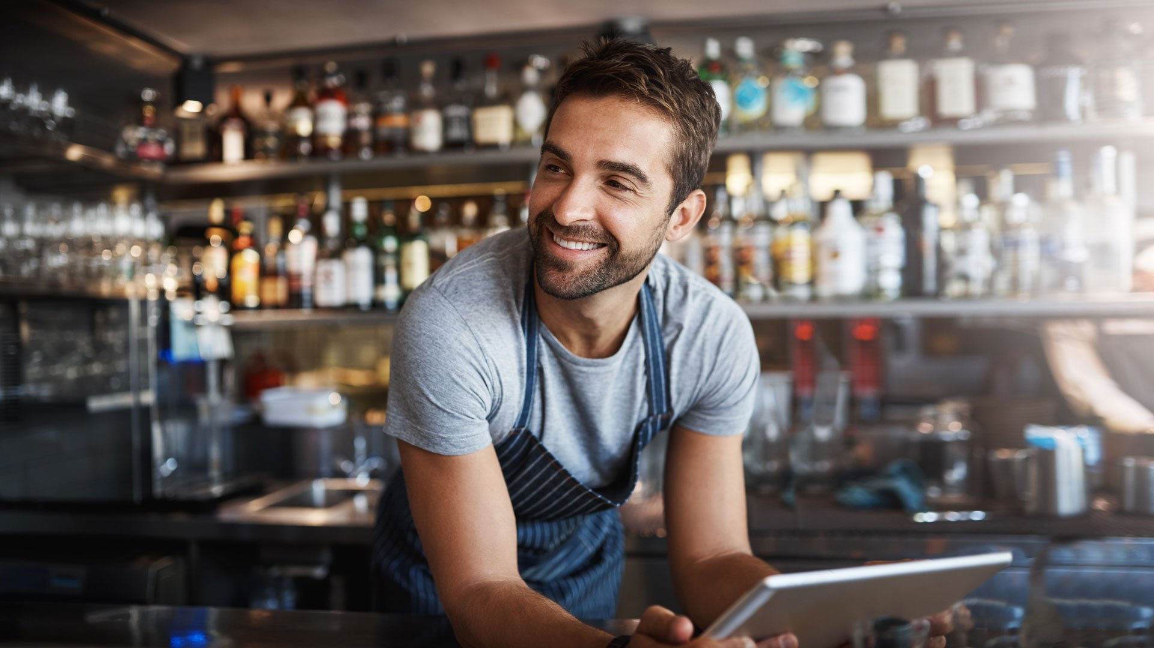
A GAME OF TWO HALVES
System Set up:
Booking system settings will need to continually be updated as we move throughout the tournament, to accommodate the different game outcomes.
If you are delivering both Festive and Footie AND you have limited bookable space, there will be some pinch points particularly in the final stages of the game.
Decide now what the pre-booked priority is for your business and what that looks like in room/table/system set up so you can respond to customer demand quickly.
© Bums on Seats 2022

Slide 11
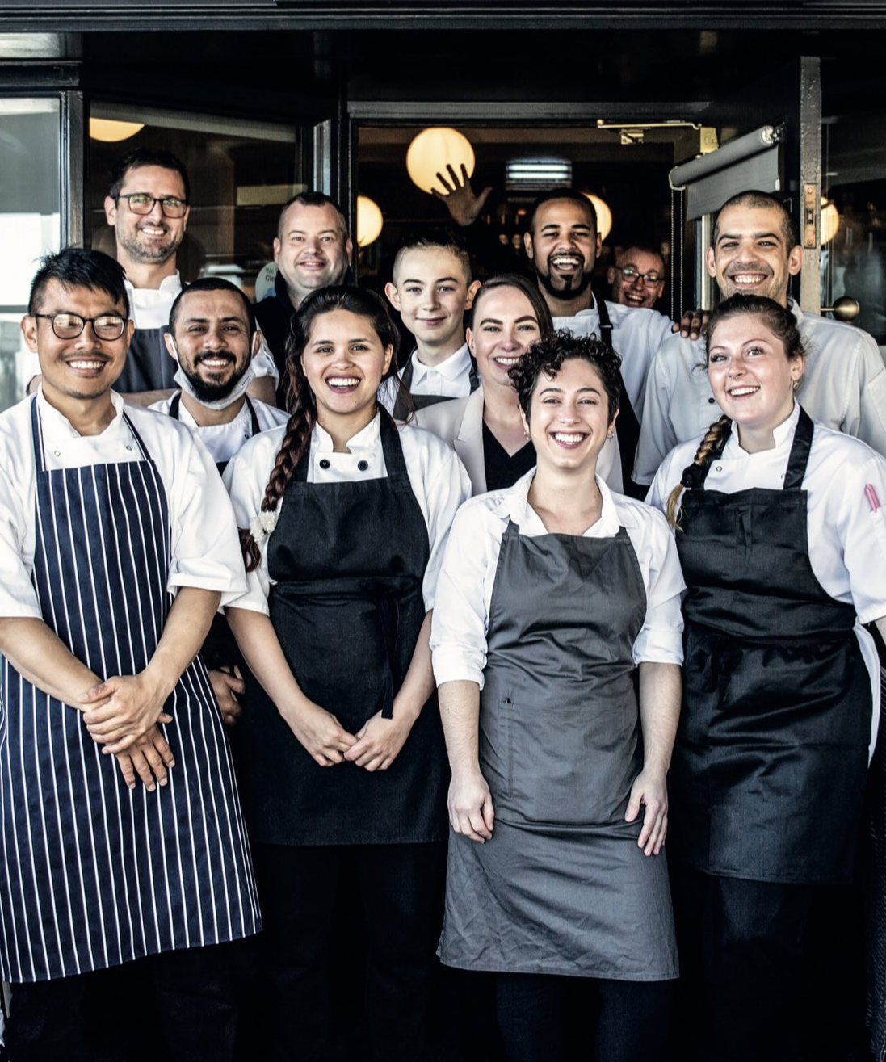
A GAME OF TWO HALVES
Tell Your Team, Tell Your Customers:
Be transparent with your customers; if you are taking festive bookings alongside footie ones be upfront in communicating this. Don’t assume customer awareness of games and times!
Ensure your whole team are briefed and updated regularly and understand the booking process and arrangements for both occasions.
© Bums on Seats 2022

Slide 12
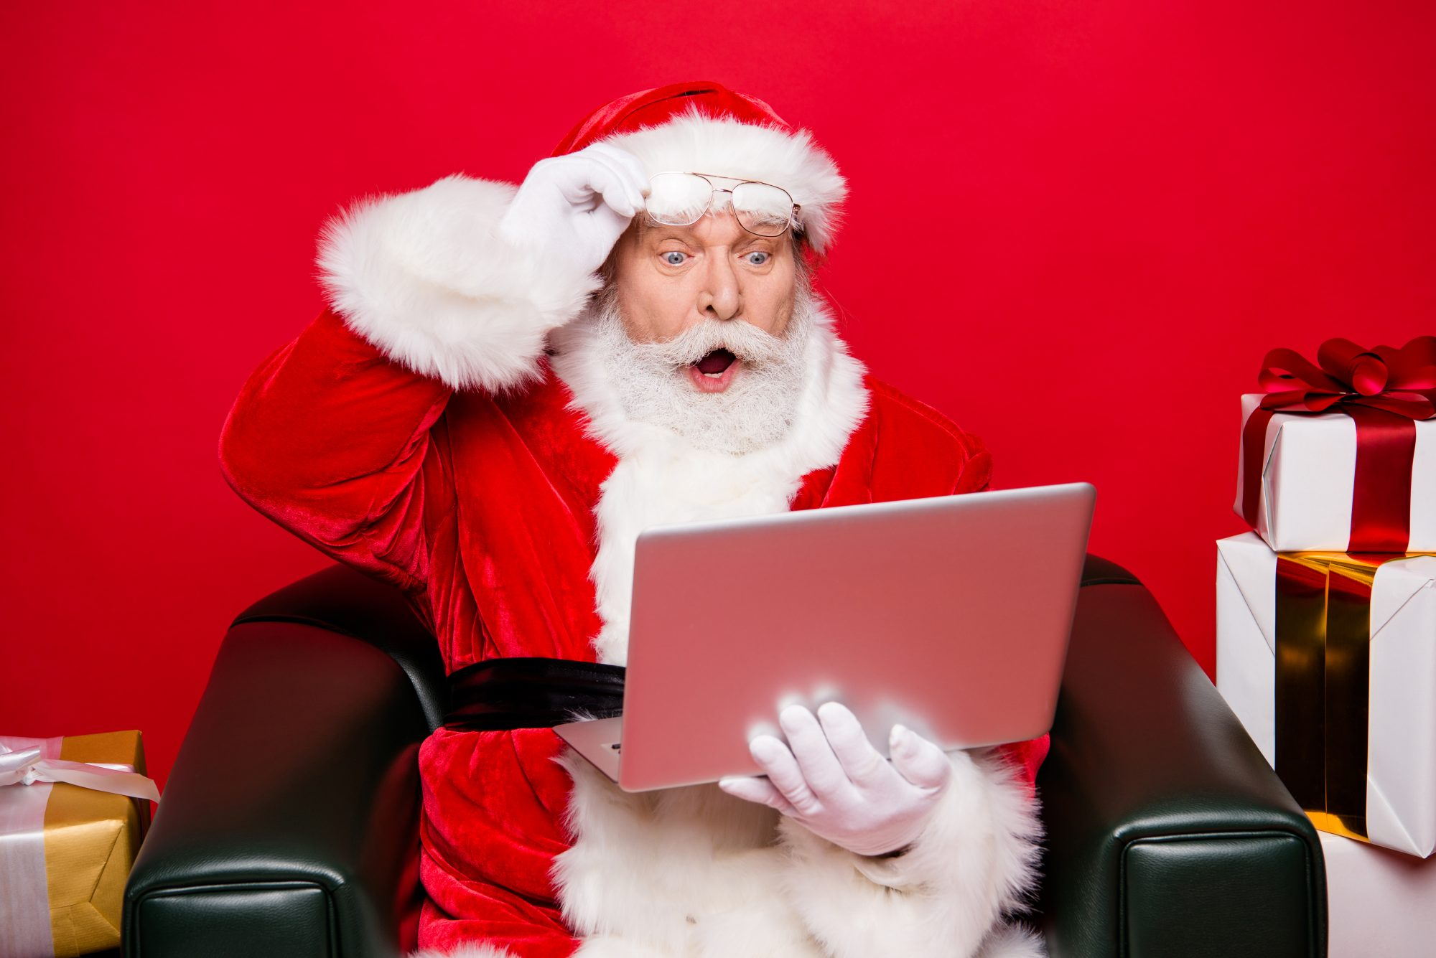
A GAME OF TWO HALVES
Planning and timings:
Keep up to date with the results and changing outcomes after the group stages so you can move quickly from Plan A to Plan B or C!
FINAL
Sunday, December 18
3pm
© Bums on Seats 2022

Slide 13
WORLD CUP BOOKER - WANTS & NEEDS
Sports fans want to
pre-book an area with a guaranteed view of a screen.
Sports fans want table ordering & payment via mobile, so they don’t miss the game!
Of publicans believe that showing live sport has helped attract customers to their venue.
29%
25%
65%
Premium Screen View & audio.
Moderate choice of drinks & food package.
Handheld tasty fast food!
Fast table service/pay at table.
Jump the Q!
No to Warm Beer and wobbly vessels!
*Data taken from Kam “The Power of Sport” white paper research March 2022.
© Bums on Seats 2021​
Notes:
1. Sports bookers preferred small number of pre-book packages – too much choice was off-putting. 2) no surprises here – Burgers/chips/wings etc. 3) Not queuing at bar & want to pay on mobile 4) No Qing at door 5) surprisingly type of beer was low on list, but venues with a later than millennial cust base will want draught. Plastic glasses –cant be avoided if that’s your licence stipulation – but wobbly plastics are a much mentioned insight on sports bookings, as is WARM BEER – yuck!

Slide 14
WORLD CUP BOOKERS – REACHING OUT
Personalised, relevant messaging. Sports Platforms such as “Fanzo” (Matchpint) are key.
Participating Fanzo pubs sell up to 11.5% more beer than those that don't during live sport.
2.1m sports fans
use FANZO
to find venues showing games
each year.
FANZO ensures
your pub comes first on local search engines for sport and games.
© Bums on Seats 2022​
Notes:
From £76 a quarter

Slide 15
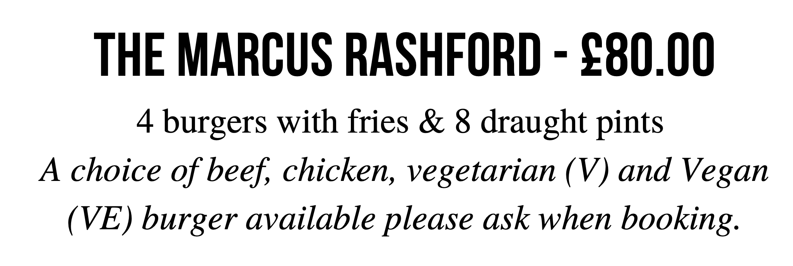
PACKAGE EXAMPLES WE LOVE
© Bums on Seats 2022​
Notes:
WHAT DOES GOOD

Slide 16
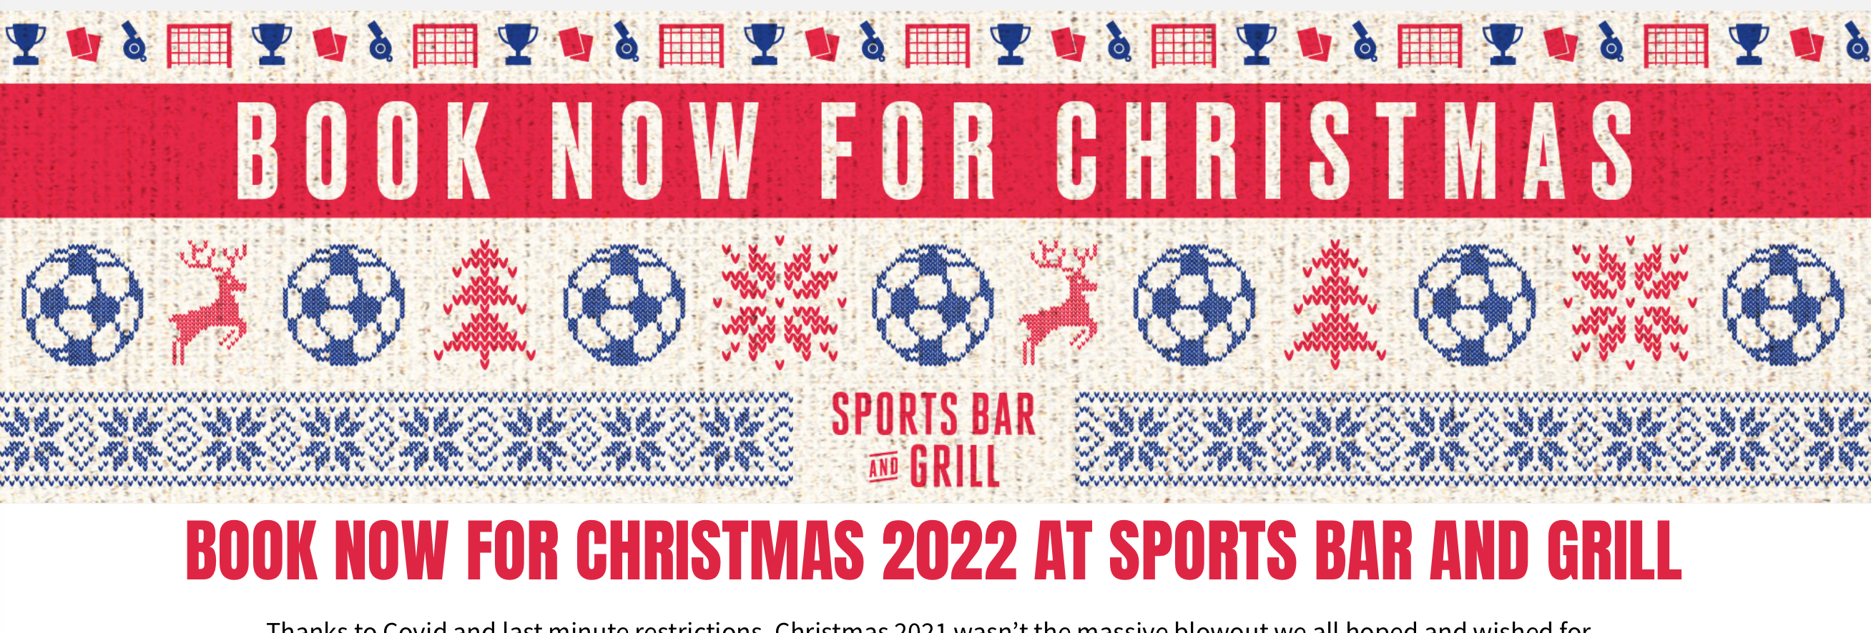
PACKAGE EXAMPLES WE LOVE
Credit: Stonegate Pubs.
© Bums on Seats 2021​
Notes:
WHERE IS THE WINE???

Slide 17
CHRISTMAS v SPORT
Just under 9 weeks until the first World Cup Game on 21st November!
Just over 10 weeks until we reach the first weekend in December!
© Bums on Seats 2022​

Slide 18
Game Specific Strategies

Slide 19
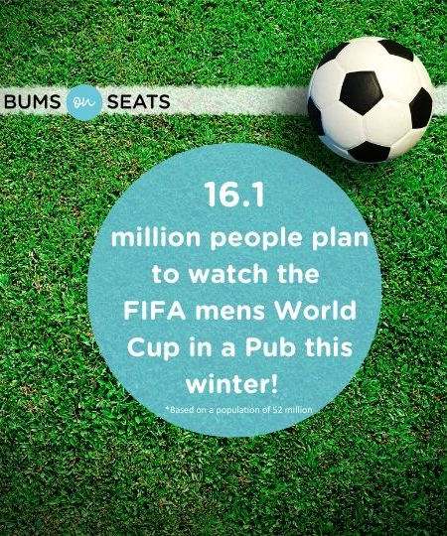
Monday November 21st
England vs Iran (1pm)
Unlikely to hamper your Christmas trade opportunities given the time of the day and day of the week.
Local offices will very likely pop out to have some lunch and watch the game.
World cup packages can be offered, but they shouldn’t be mandatory.
Think card authentications.
Monday 21st November
Group B Games
© Bums on Seats 2022​

Slide 20
Friday November 25th
England vs United States (7pm)
Remember, Friday lunchtime slots are second in Christmas party popularity only to Thursday nights.
This match offers the ideal opportunity for day-into-night corporate Christmas parties.
Venues should consider:
Higher minimum spends split into AM and PM, and depending on numbers:
Offering an exclusive hire for the world cup game following their lunch against a separate world-up themed package.
Offering to save an them an area for an additional spend when you open up back up to core trade.
Inform them the table/area/venue must be vacated by 5pm - this allows you enough turnover time to prepare for the evening’s trade.
Remember to let them know if you are fully booked when their slot ends, so they can find an alternative venue for the game!
Friday 25th November
Group B Games
© Bums on Seats 2022​

Slide 21
Tuesday November 29th
Wales vs England (7pm)
This will be a popular game.
You may decide to charge consumers a ticket price including a drink, a minimum spend or make an entry-level package mandatory, depending on the nature of your venue and its popularity for sports matches.
It’s likely to be a popular date with corporate hires for some venues– ensure your minimum spend reflects the fact it’s a match day if you are popular with sports bookings.
Monday 29th November
Group B Games
© Bums on Seats 2022​

Slide 22
What fixtures will England play if they top the group?
They’ll play on Sunday, December 4th, 7pm GMT.
A quarter-final on this path will be on Saturday, December 10th.
What fixtures will England play if they come second in the group?
They’ll play on Saturday, December 3rd, 3pm GMT.
A quarter-final on this path will be on Friday, December 9th.
The corporate market wont be the focus for Saturday and Sunday games, this is all about how showing the game might affect your core trade. Be tactical – what can you deliver that will be the most profitable?
The wet spend will be high for these matches – be prepared!
You may choose to make world cup packages mandatory, depending on your venue – but absolutely take a deposit or at the very least a card authentication to hold the space or consider selling tickets.
Friday 9th December will be another mega date for parties vs world cup. Remember to charge more for parties to stay into the evening, or let them know their cut off-point to enable you to turn the venue over.
Our Mission, Our Vision
Group Play-Offs
© Bums on Seats 2022​

Slide 23
Quarter-Final 1 Winner vs Quarter-Final 2 Winner
Tuesday, December 13th at 7pm.
Quarter-Final 2 Winner vs Quarter-Final 4 Winner
Wednesday, December 14th at 7pm.
THIRD-PLACE PLAY-OFF - Saturday, December 17th at 3pm.
FINAL - Sunday, December 18th at 3pm.
Consider increasing your base minimum spends/package price for hires and groups in advance for these midweek dates. Not enough to price the mid-week customer out, but to help to cover any potential loss of revenue if England make it this far. Hedge your bets!
Make the weekday daytime parties aware they will need to pay extra to stay into the evening if England make it through, this is where bolt-on options work very well.
Customers will want and expect to pay for an experience to watch the finals – go all in on packages and premiumisation options, especially for larger groups.
The weekend dates will be very busy with core trade for most venues. Have a plan in place to make the most of what’s deliverable within your venue without impacting guest experience.
Finals!
© Bums on Seats 2022​

Slide 24
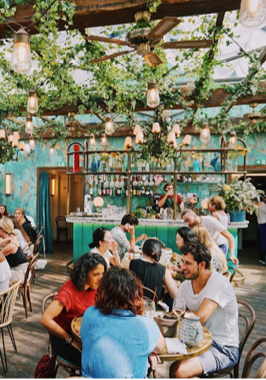
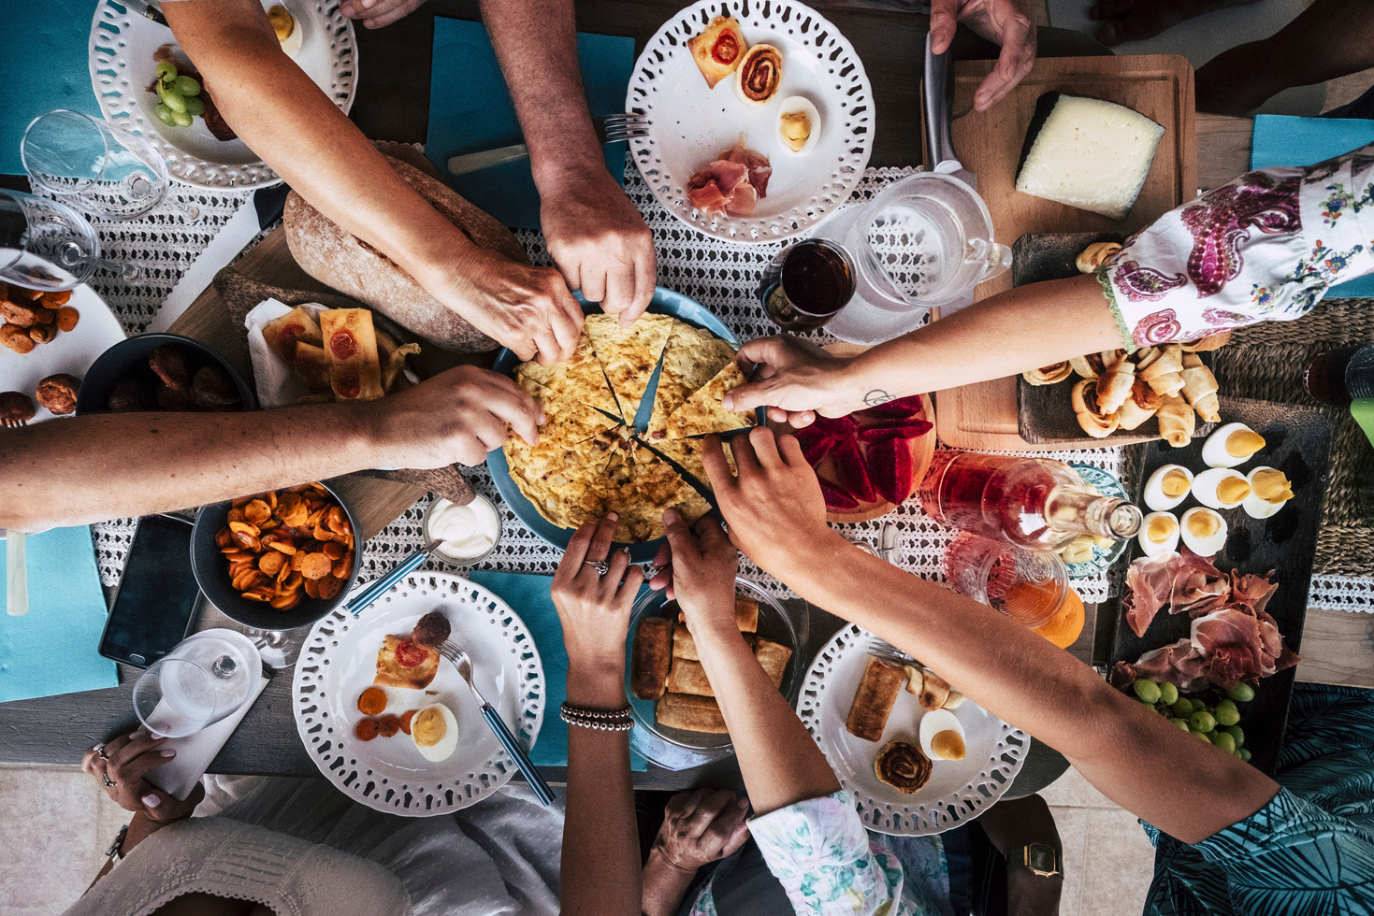
www.bumsonseats.org
contact@bumsonseats.org
Bums On Seats HQ
154 – 160 Fleet Street
EC4A 2DQ
0333 090 8527
@bumsonseatshosp

